Slide 1
Crowd Counting with
Deep Structured Scale Integration Network
Lingbo Liu

Slide 2
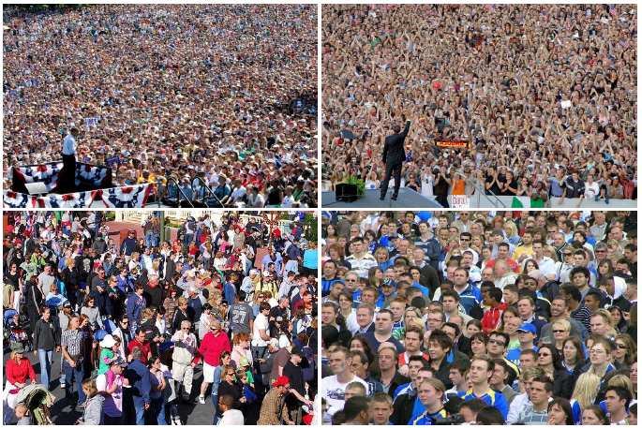
Crowd Counting
Definition:
To estimate of the number of person in still images or video frames
Application :
Traffic Monitoring, Crowd Behavior Analysis

Slide 3
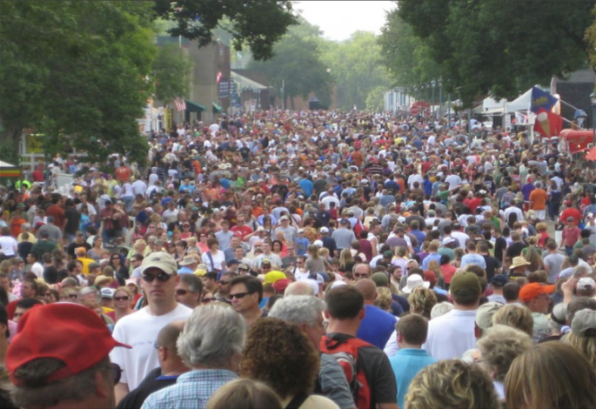
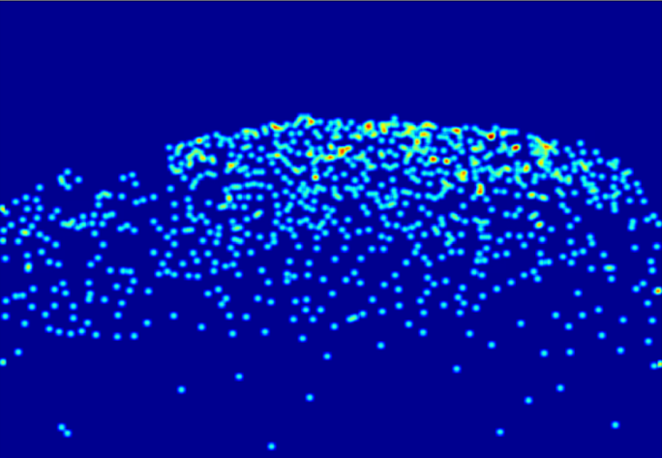
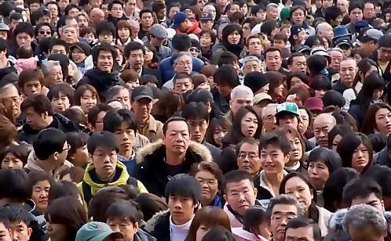
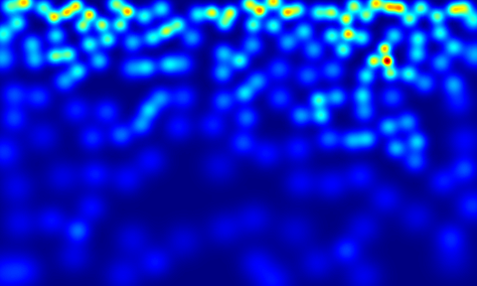

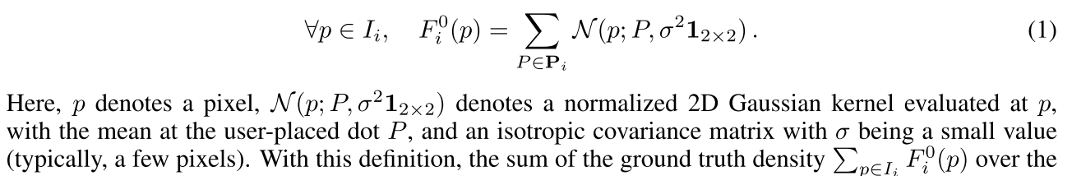

Crowd Counting
Ground Truth Density Map Generation

Slide 4
Crowd Counting
Challenge :
Scale
Other: rotation , extreme occlusions, changes in lighting

Slide 5
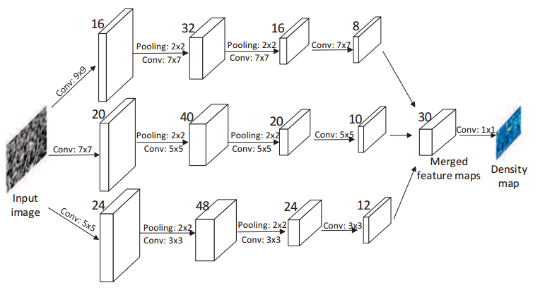
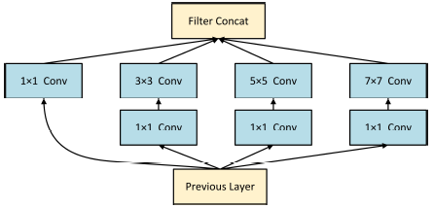
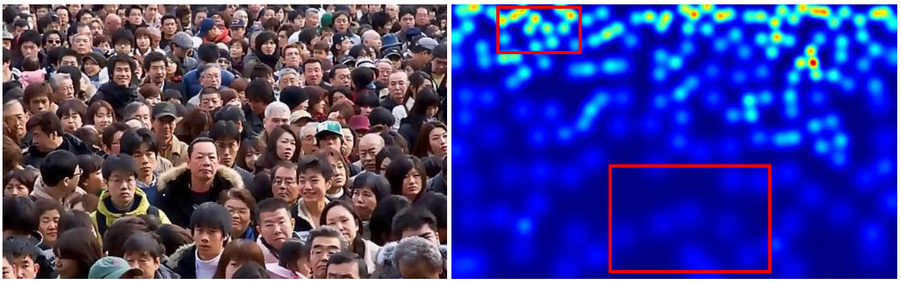
Motivation
The features at different layers have different information and are highly complementary. Most previous methods do not fully exploit their complementarity.
The crowd density maps contain rich information about people scale, which can be captured by an effective loss function.

Slide 6
Motivation
The features at different layers have different information and are highly complementary. Most previous methods do not fully exploit their complementarity.
Structured Feature Enhancement Module (SFEM): robustly fuse and enhance multi-scale/multi-level features by fully exploiting their complementarity with a message passing mechanism

Slide 7
Motivation
The crowd density maps contain rich information about people scale, which can be captured by an effective loss function.
Multi-scale Structural Similarity Loss (MS-SSIM Loss): force networks to produce locally consistent estimation results, which helps our model to learn the local correlation of the individuals of various scales on density maps.

Slide 8
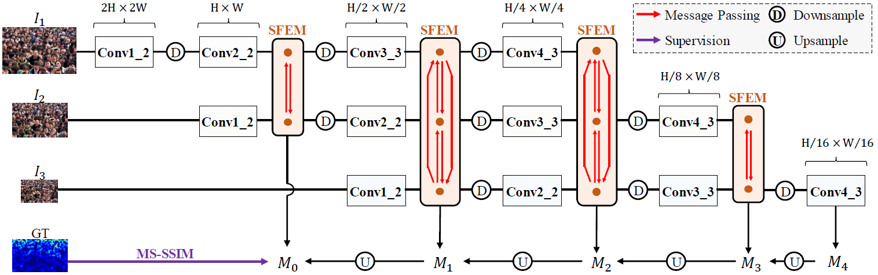
Deep Structured Scale Integration Network
Structured Feature Enhancement Module (SFEM)
Multi-Scale Structural Similarity Loss (MS-SSIM Loss)

Slide 9
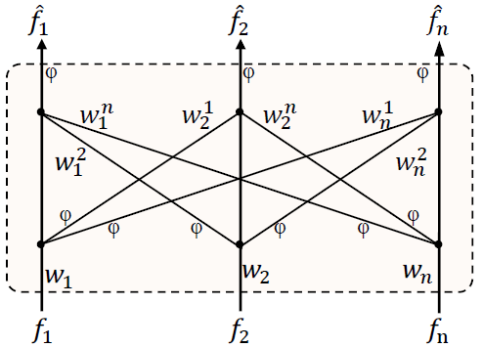
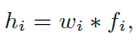
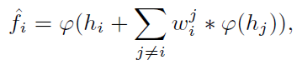
Deep Structured Scale Integration Network
Structured Feature Enhancement Module (SFEM)

Slide 10
Deep Structured Scale Integration Network

Slide 11
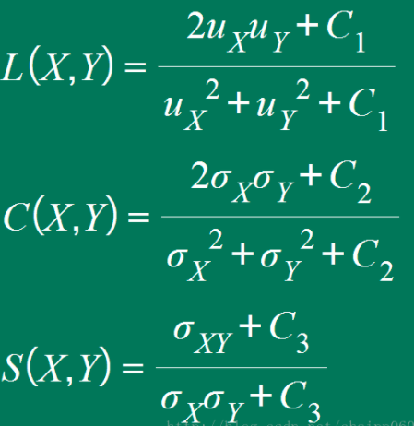
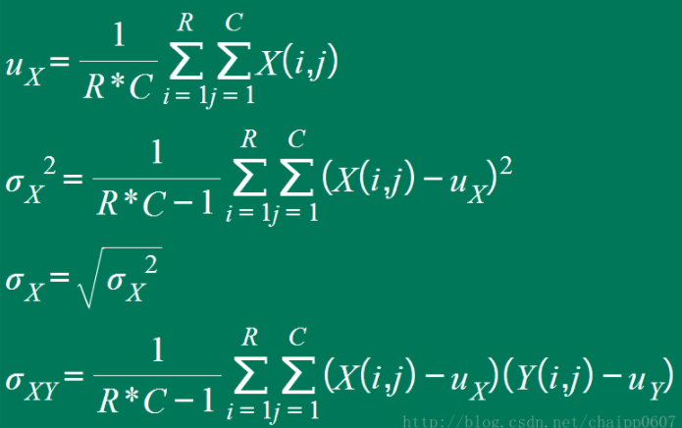
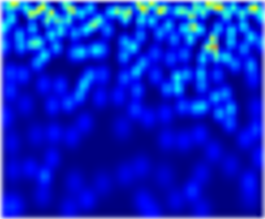
Deep Structured Scale Integration Network
Structural Similarity
Luminance
Contrast
Structure
Image
X
Y

Slide 12
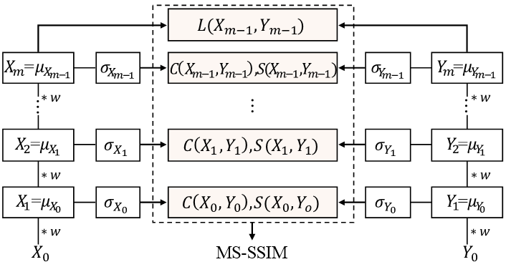
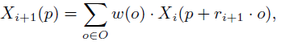
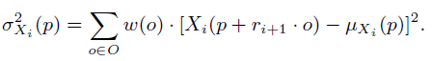
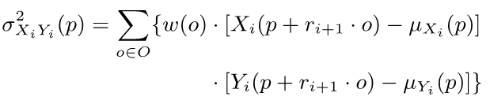
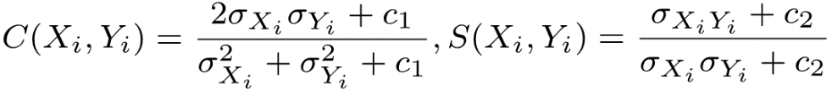
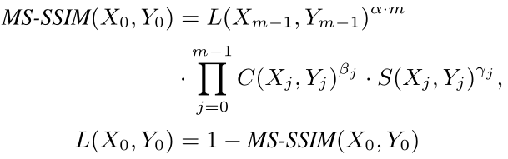
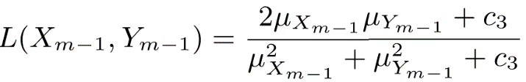
Deep Structured Scale Integration Network
Multi-Scale Structural Similarity Loss (MS-SSIM Loss)

Slide 13
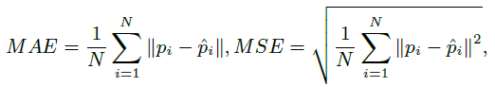
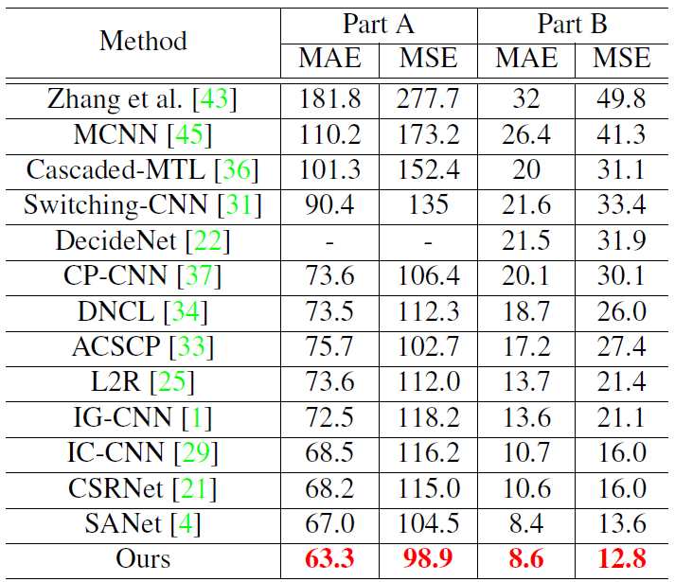
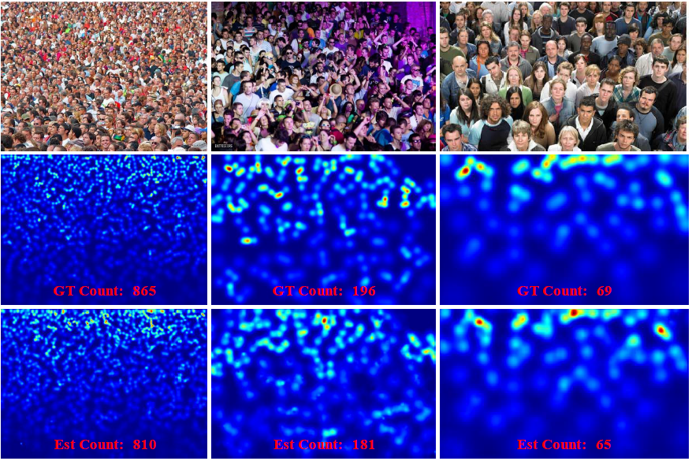
Experiment
Evaluation Metric:
Shanghaitech Dataset

Slide 14
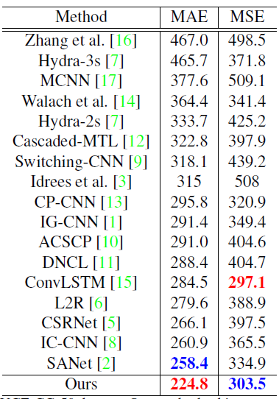
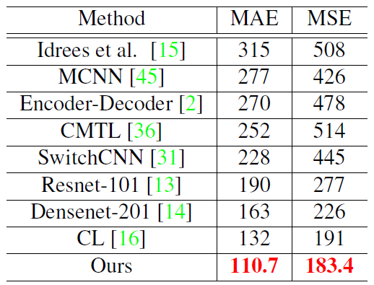
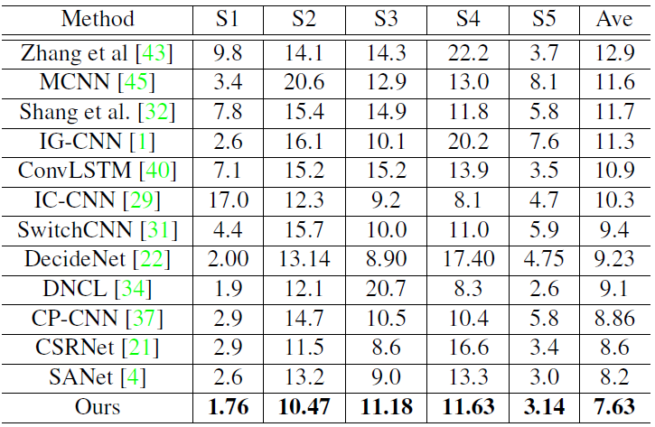
Experiment
UCF-QNRF
WorldExpo’10
UCF_CC_50
Notes:
the overall precision, recall, F1 (OP, OR, OF1)
the per-class precision, recall, F1 (CP, CR, CF1)

Slide 15
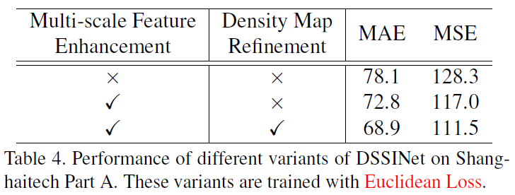
Component analysis

Slide 16
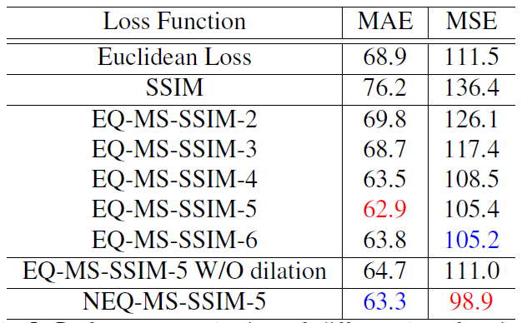
Component analysis

Slide 17
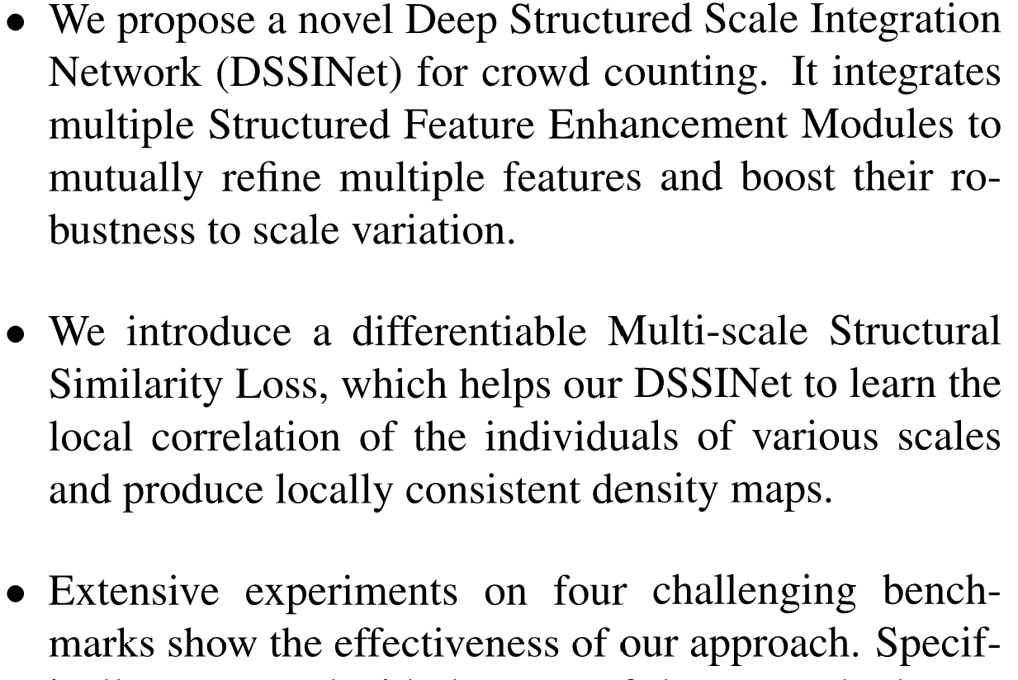

Conclusions
Notes:
the overall precision, recall, F1 (OP, OR, OF1)
the per-class precision, recall, F1 (CP, CR, CF1)

Slide 18
Crowd Counting with
Deep Structured Scale Integration Network
Lingbo Liu

